Slide 1



BULK DATA FILES
TMDB
Search (get tmdb Id from title)
Movie (get details from tmdb Id)
Credit (get credits from tmdb Id)
My movies.csv
Title
Personal ratings
View date
Get Movies.py
Append details & casting to my list of movies
MyMoviesDetails
CastingRaw.csv
2k items
TMDB
Movie
Cleanup of entries w/o Id
Get All Movies.py
Leeches all details up to latest tmdb movies (can be resumed)
AllMovies
Details.csv
470k
AllMovies
DetailsCleaned.csv
330k
GetCastingFromId.py
Leeches casting & crew from a list of tmdb Id
(can be resumed)
allmovies_cleaned
ID Only.csv
330k
AllMovies
CastingRaw.csv
330k
Take only list of tmdb Id
TMDB
Credit
Python IDE
Jupyter Notebook

Slide 2
PROBLEM 1a : DETERMINE CLUSTERS OF SIMILAR DIRECTORS
Genre, langage and various features from tmdb
DIRECTOR FEATURES
ExtractDirectorFeatures.py
Compute fidelity, nb of movies, gender
AllMovies
CastingRaw.csv
330k
director_attr.csv
330k x 5 features
Feature Engineering
Combine, normalize features
Compute correlation & PCA
Clustering
KMean
director_avg.csv
330k x 40 features
AllMovies
CastingRaw.csv
330k
Director_AvgMovieMakingTime
Compute statistics on director genre, creation time, favorite language, ..
Conclusion
Weak PCA (first eigenvalue 17%)
Clustering not conclusive / difficult to represent or interpret
Very few correlated features
director_avg.csv
330k x 35 features
AllMovies
DetailsCleaned.csv
330k

Slide 3
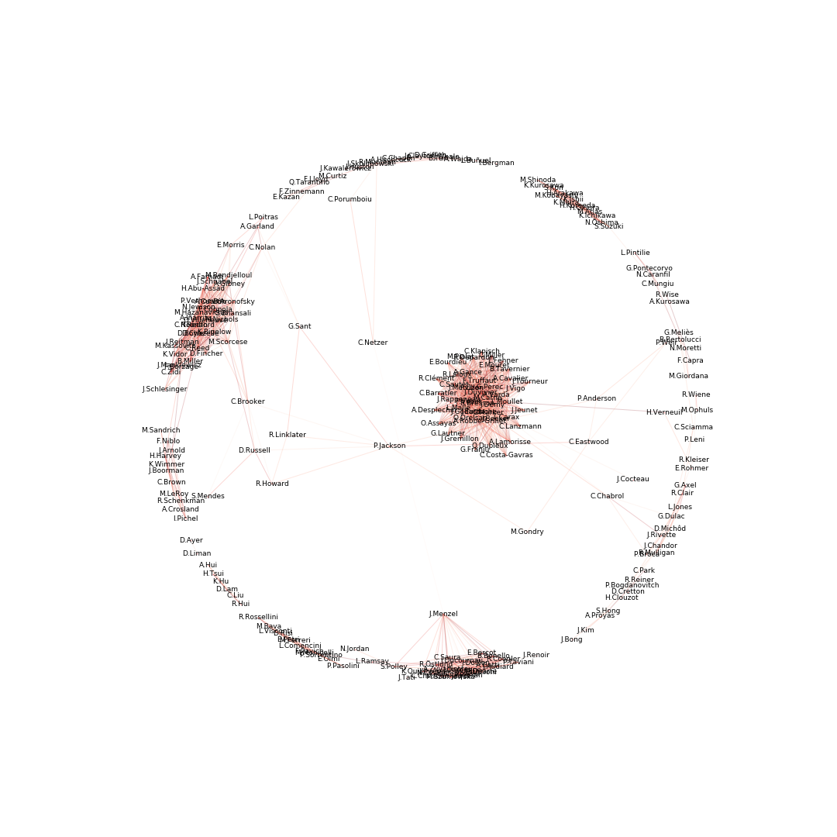
PROBLEM 1b : DETERMINE CLUSTERS OF SIMILAR DIRECTORS
From wikipedia summary - NLP
Clustering Directors thru NLP
Retrieve wikipedia summary
Clustering Directors thru NLP
X100 execution (TFIDF + Kmean)
Create network graph based on link strenght
Wikipedia
Search
Get summary
From my 500 favorite directors
Conclusion
Much funnier & meaningful
At least algo can identify nationality, critical acclaim and even genre of predilection
500 favorite directors_with wikipedia summary.csv
500 lines

